Slide 1

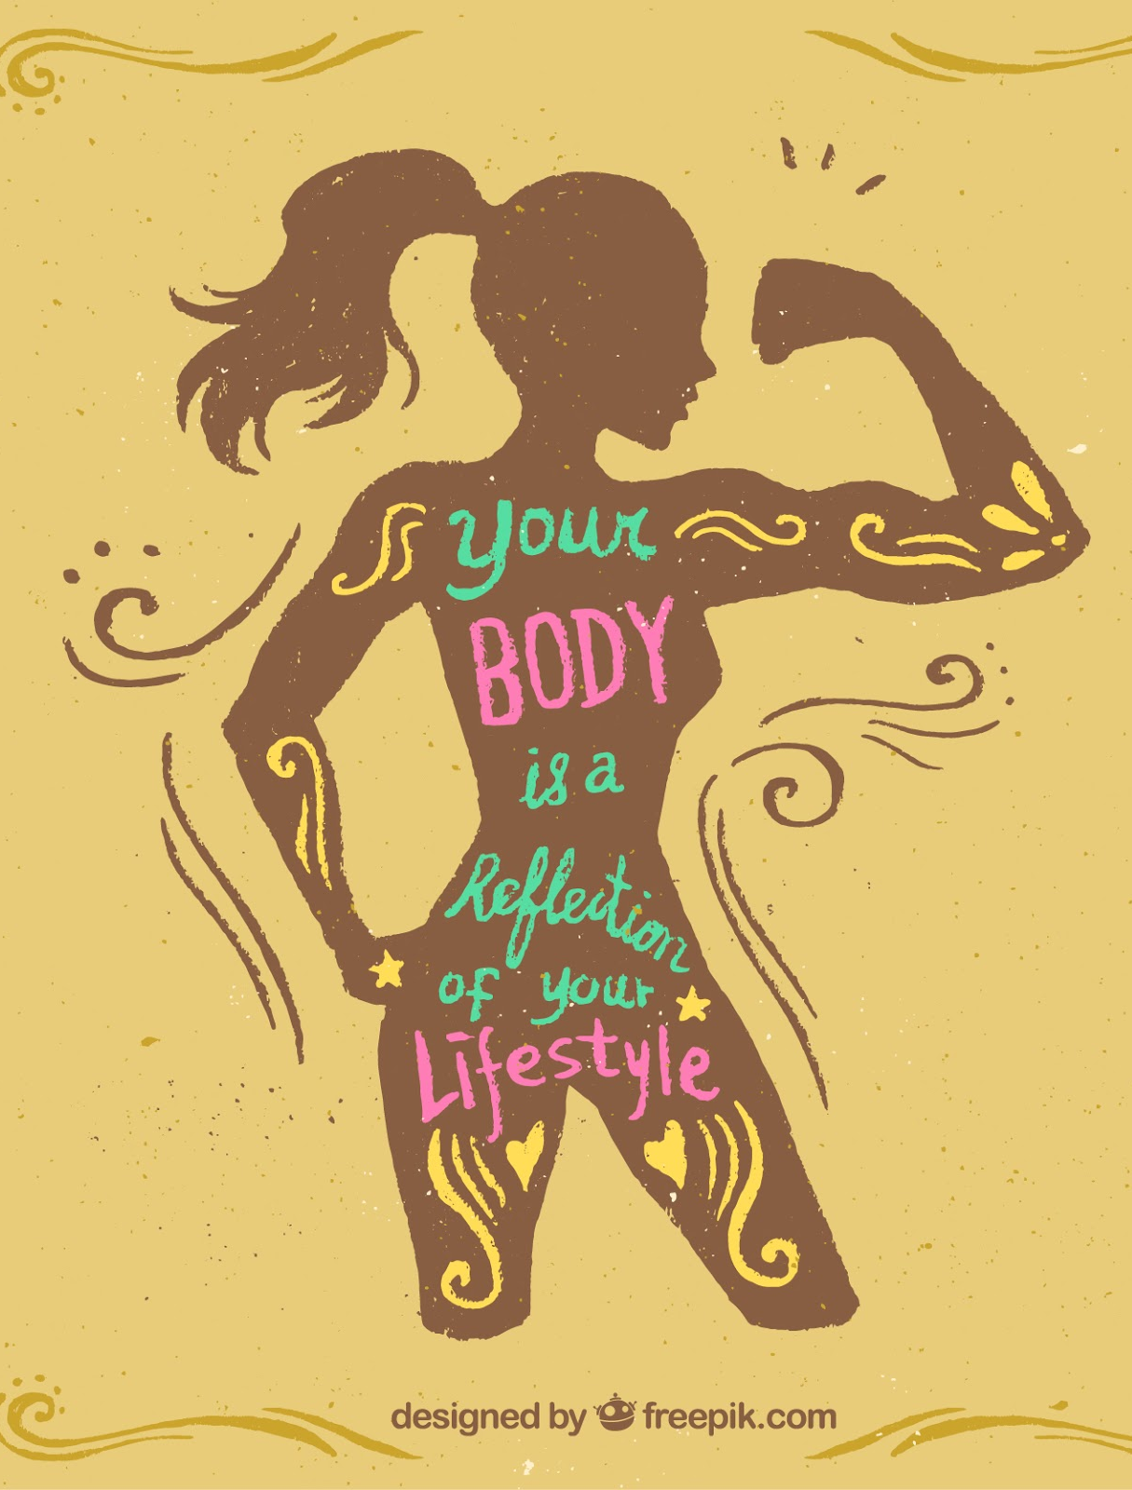
Healthy Routine Blueprint
Transforming Your Lifestyle Through Data Analytics
By : Mrs. Anushka More

Slide 2
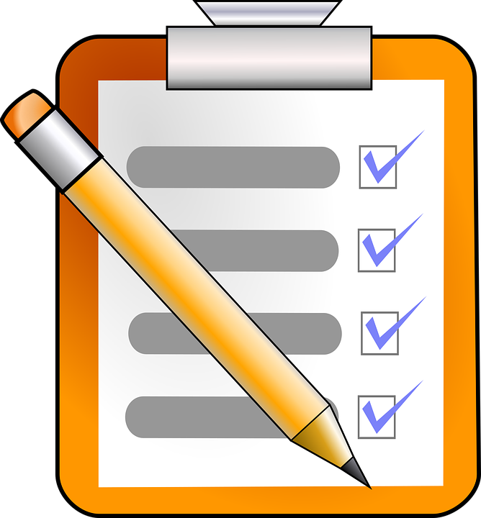
Objective
Design a personalized daily routine that fosters better health through structured analysis and actionable steps.

Slide 3
Step 1: Description
Envisioning a healthier you!
The goal is to establish a sustainable daily routine encompassing exercise, nutrition, hydration, and sleep for overall well-being.

Slide 4
Step 2: Plan
Setting the foundation for success.
Optimize time management for regular exercise, improved food choices, and sufficient rest.
Allocate specific time slots for health activities to ensure consistency.

Slide 5
Step 3: Prepare
Assess resources and feasibility.
Evaluate time and budget constraints for fitness activities and dietary improvements.
Identify opportunities for cost-effective options like online fitness resources.

Slide 6
Step 4: Process
Seek expert insights and practical solutions.
Consult a nutritionist for tailored dietary recommendations.
Research local gyms or yoga studios offering programs for cardiovascular health, strength, flexibility, and weight management.

Slide 7
Step 5: Analyze
Compare and decide wisely.
1
Select the best services and apps based on cost, quality, and compatibility with your lifestyle.
2
Identify a free reminder app to streamline task management, such as meal planning and water intake tracking.
3

Slide 8
Step 6: Share
Build a support system.
Share your dietary habits with a nutritionist to refine meal plans.
Set reminders for grocery shopping and hydration to stay on track.

Slide 9
Step 7: Act
Take the leap into action!
Morning Ritual: Wake up early and walk for 35 minutes, monitoring steps and heart rate using a smartwatch.
Yoga at Home: Follow free YouTube videos to save on fitness costs.
Hydration Reminder: Set alarms for drinking water every two hours.
Meal Prep: Create a weekly menu based on nutritionist suggestions and prepare meals ahead of time or delegate cooking tasks.
Work Breaks: Incorporate short walks every 20–30 minutes to boost energy and productivity.
Sleep Tracking: Wear a smartwatch to monitor and improve sleep patterns.

Slide 10


Thank you

